Slide 1
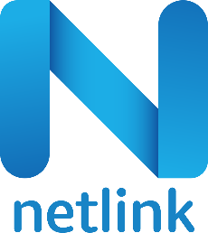
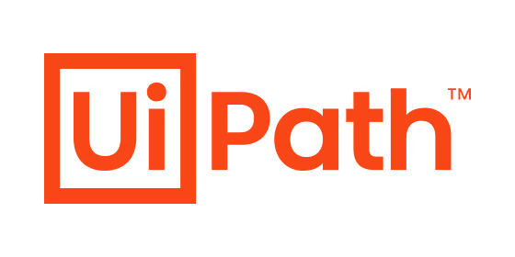
Immediate Business Results
Netlink RPA Capabilities
Silver Partner

Slide 2

RPA Offerings
Licensing
Consulting
Landscape Understanding
Licensing proposals
Reselling
Inventory list down of processes
Opportunity Assessment of RPA
Process Pipeline Prioritization
Performance Assessment
Implement & Support
UiPath COE
Process and Robots Architecture
POC Development and ROI Analysis
Development, Documentation, Testing and Production
Training and Establishing COE
15+ certified UiPath Developers
5+ UiPtah Solution Architects
20+ Process Mining Experts
Implemented 200+ Automations

Slide 3






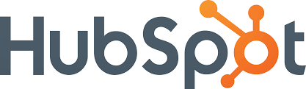




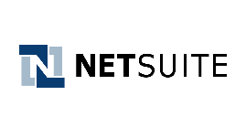


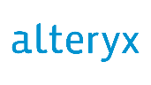



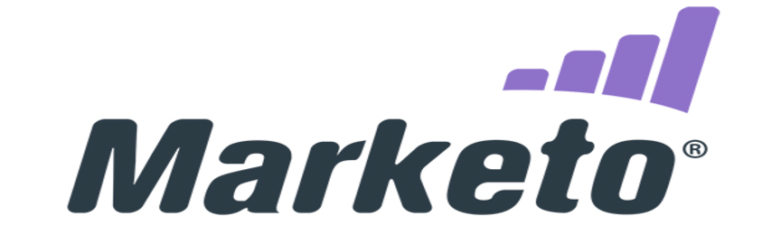








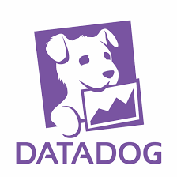








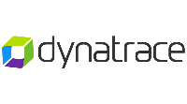



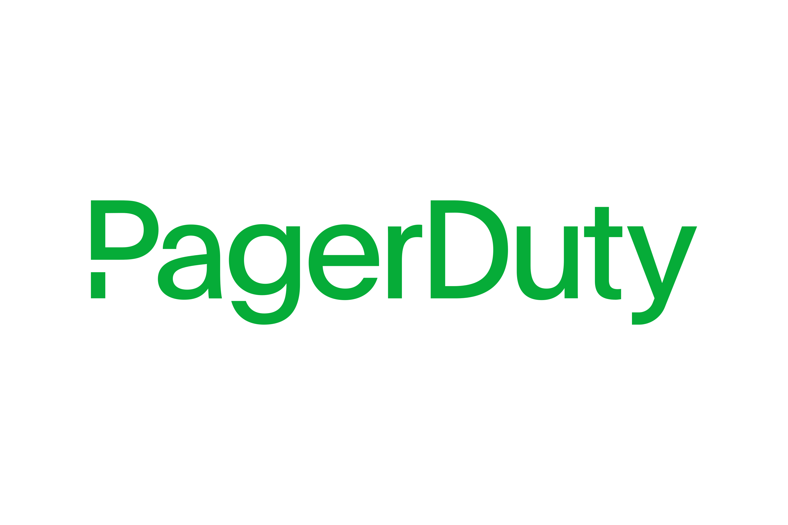
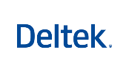


Integration Expertise
ERP Applications
SAP
QAD
Salesforce
Web Applications
SharePoint
Custom Apps
Active Directory/LAPS
Legacy Systems
Mainframes
OCR
Excel Automation
Email Automation
Automation layer

Slide 4
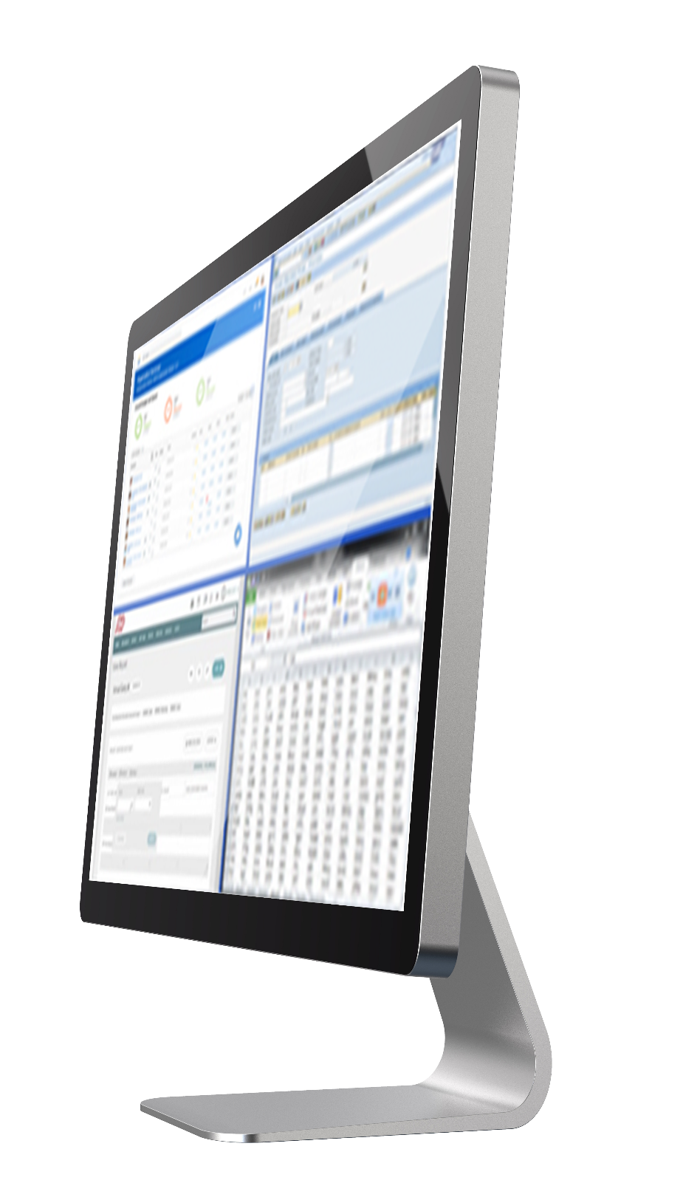
Why UiPath?
See Read the screen
15 years of continuous innovation—94 patents in Document Understanding, AI Computer Vision, more
Think Understand and decide what to do
ML- & AI-powered skills enabling robots to perform judgment-based tasks
Do
Interact with applications and data
Auto-healing robots that adjust to runtime issues
With AI Computer Vision, Document Understanding, and AI-powered skills,
robots can interact with screens, systems, and data like people do

Slide 5

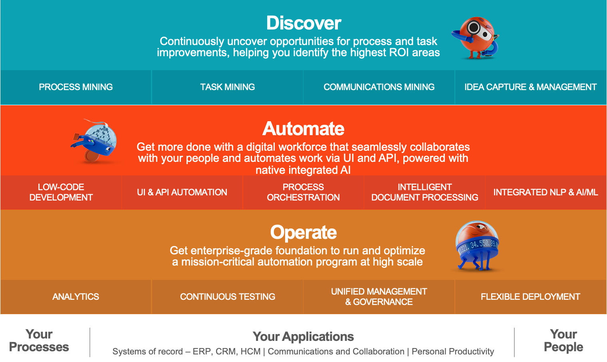
Fully Automated Enterprise
Complete end-to-end platform for automation
Everything to build, manage, run, engage, govern, and measure automation at enterprise scale
Best-in-class UI, API, and AI automation
Whatever you need to automate a fast, reliable process
AI built in across the platform
Higher-order robot skills; simple insertion of models into automated processes
Proven ability to scale
The largest automation programs in the world run on the UiPath Platform
Robust governance
Integrated compliance, audit, and security capabilities that modern enterprises require
Cloud-first, customer choice delivery
Fast, fast, frictionless delivery for SaaS and self-hosting
Notes:
The UiPath Platform is built to deliver automation at enterprise scale.
-A complete end-to-end capability with everything in one place.
-Best-in-class UI automation plus API integration plus advanced AI so you can automate across your technology landscape and expand into a broader set of processes.
-Scalability—the largest automation installations in the world run on UiPath.
-The governance and security that enterprises require.
-And the same deployment experience across the UiPath Automation Cloud and on premises with UiPath Automation Suite

Slide 6
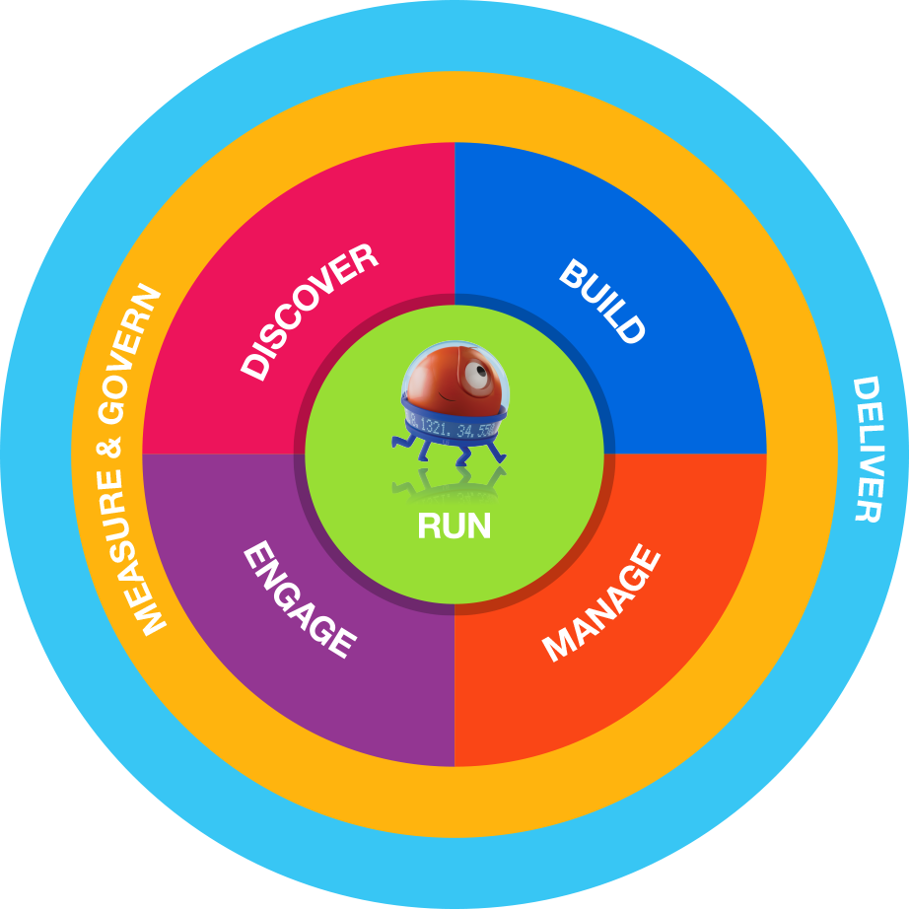






UiPath Platform for the fully automated enterprise
Discover and manage automation opportunities powered by AI and your people
Automation Hub
Consolidate, prioritize, and manage automation opportunities in one place— and manage a crowd-sourced idea stream
Task Capture
Record employees’ tasks to create perfect process maps that serve as blueprints for developers and citizen developers
Task Mining
Capture and apply AI to employees' day-to-day desktop activities to identify repetitive tasks that should be automated
Process Mining
Use advanced AI to extract and analyze process patterns hidden in your ERP system data
Automation Users
RPA & Citizen Developers
IT Operations
Process Analysts
CoE Leads
Notes:
Discover
Discover what to automate with process mining powered by AI
Build
Professional developers, citizen developers, and employees create automations
Manage
Securely deploy and manage automations from anywhere, at scale
Run
Robots work with your applications and your people to carry out automations
Engage
People
Measure and Govern automation programs to align with business outcomes
and robots work together to automate complete processes

Slide 7
UiPath Platform for the fully automated enterprise
Build UI + API + AI-powered automations
Studio Family
Give RPA developers a powerful, easy-to-use, visual build environment with Studio—and citizen developers simplified, no-code automations with StudioX
Document Understanding
Use our powerful AI to extract information from documents, images, and other visual material—all kinds, shapes, sizes
Integration Service
Access UI and API integration from the same place; deploy both in a single automation
Marketplace
Easily access quality pre-built components to extend what can be automated and cut build time and effort
RPA & Citizen Developers
Notes:
Build
Professional developers, citizen developers, and employees create automations
Manage
Securely deploy and manage automations from anywhere, at scale
Run
Robots work with your applications and your people to carry out automations
Engage
People
Measure and Govern automation programs to align with business outcomes
and robots work together to automate complete processes

Slide 8
UiPath Platform for the fully automated enterprise
Manage, deploy, and optimize automations at enterprise scale
Orchestrator
Provision, deploy, trigger, monitor, measure, and track attended and unattended robots easily, centrally
AI Center
Easily incorporate AI and machine learning models into automations
Test Manager
Get automated enterprise testing that's lightweight, open, flexible, and customizable
Data Service
Model, manage, and store business data and use it quickly and easily in multiple automations
Insights
Get the analytics you need to track and measure automation impact, performance, and ROI
Automation Users
RPA & Citizen Developers
IT Operations
Notes:
Discover
Discover what to automate with process mining powered by AI
Build
Professional developers, citizen developers, and employees create automations
Manage
Securely deploy and manage automations from anywhere, at scale
Run
Robots work with your applications and your people to carry out automations
Engage
People
Measure and Govern automation programs to align with business outcomes
and robots work together to automate complete processes

Slide 9
UiPath Platform for the fully automated enterprise
Run automations through robots that work with your applications and data
Unattended Robots
Get tireless robots to work on task-heavy, long-running workflows—and check in with you when they need direction
Attended Robots
Provide everyone a digital sidekick to help with their everyday tasks
Automation Cloud Robots
Unlimited SaaS robot capacity available when you want with a few clicks—serverless or VM-based
Test Robots
Test automations and applications quickly and easily with robots that execute processes when you want, document issues, and report back
RPA & Citizen Developers
Test Teams
Notes:
In the beginning there was….
UiAutomation, Attended Unattended
API Integrations and Long Running workflows
Citizen Developers
Test Automatons
AI
Discover
Engage
Measure
Automation Cloud
I mentioned hyperautomation and how it underpins and consolidates many of those technology trends. We have now have a platform that spans the whole automation lifecycle and is comprehensive in scope
Discover
Discover what to automate with process mining powered by AI
Build
Professional developers, citizen developers, and employees create automations
Manage
Securely deploy and manage automations from anywhere, at scale
Run
Robots work with your applications and your people to carry out automations
Engage
People and robots work together to automate complete processes
Measure
Embedded analytics give you deep insights into business metrics, not just robot metrics
Source for
$1 invested in UiPath can return$15 or more in the same year
The Department of Work and Pensions (DWP) >> https://www.uipath.com/solutions/customer-success-stories/dwp-government
Build millions of hours of digital workforce capacity
SMBC >> https://www.uipath.com/blog/6-ways-uipath-makes-banks-more-efficient
Achieve 30-40% improvement in operational metrics
Everest Group, Smart RPA Playbook >> https://www.uipath.com/company/rpa-analyst-reports/everest-smart-rpa-playbook
(implies RPA + AI)

Slide 10
UiPath Platform for the fully automated enterprise
Engage people and robots as one team for seamless process collaboration
Apps
Create user-friendly apps interfaces for your automations with our low-code apps builder
Assistant
Give everyone easy desktop access to automations that take the drudgery out of their days
Action Center
Make human-in-the-loop processes easy with simplified check-ins and handoffs from robots to people, and vice-versa
Automation Users
RPA & Citizen Developers
Process Analysts
IT Operations
Notes:
Discover
Discover what to automate with process mining powered by AI
Build
Professional developers, citizen developers, and employees create automations
Manage
Securely deploy and manage automations from anywhere, at scale
Run
Robots work with your applications and your people to carry out automations
Engage
People
Measure and Govern automation programs to align with business outcomes
and robots work together to automate complete processes

Slide 11

UiPath Platform for the fully automated enterprise
Measure and govern your automation program centrally, end-to-end
Automation Hub
Consolidate, prioritize, and manage automation opportunities in one place— and manage a crowd-sourced idea stream
Orchestrator
Provision, deploy, trigger, monitor, measure, and track attended and unattended robots easily, centrally
Insights
Get the analytics you need to track and measure automation impact, performance, and ROI
Trust and Security
Meet your privacy, security, and compliance requirements with governance and security built in across the Platform including SOC 2 and HIPAA attestations, end-point security for robots, and more
CoE Leads
CIOs
Notes:
Measure and govern: Enterprise-strength governance, control, and security built in throughout the platform ; full program measurement and impact through Insights.
Automation Suite: The cloud native UiPath Platform delivered as a single, containerized suite. One-package install on-prem, in public cloud or hosted

Slide 12
UiPath Platform for the fully automated enterprise
Deliver your way—UiPath Automation Cloud™ SaaS or self-hosted
UiPath Automation Cloud
Start instantly, scale infinitely with complete cloud-based enterprise automation. No infrastructure required!
Automation Suite
Self-host the Automation Cloud experience with a single-install Linux package, including both products and platform. (Requires IT management).
Standalone Installation
Self-host and integrate individual products on physical/virtual hardware. (Requires IT management).
IT Operations
CIOs
Notes:
Automation Cloud: The cloud native UiPath Platform delivered as SaaS from UiPath. No installation required.
Automation Suite: The cloud native UiPath Platform delivered as a single, containerized suite. One-package install on-prem, in public cloud or hosted

Slide 13
Case Study - 1
Banking
Automation of User Onboarding
Background & Scope
Rule based automation of user management across organizational systems based on source HRMS System.
Active Directory
LAPS
Finacle
E-Learning
Challenges
High human intervention
Involvement of Multiple systems
Mismatch of data in multiple systems
Netlink Solution
We developed RPA Solution to automate the creation of a new user with default password, edit the existing users and disabling users in Active Directory.
The developed RPA solution also creates the users in LAPS, Finacle and E- learning Software.
Results
High ROI due to high volume, disparate systems, multi-step process
Instantaneous onboarding of new employees
Increased data integrity

Slide 14
Case Study - 2
Banking
3-Way reconciliation of UPI transactions
Background & Scope
Automate the reconciliation of UPI transactions between multiple systems.
NPCI Portal (Settlements)
Finacle (Core Banking)
Switch (ATM Network)
Challenges
Multiple Manual steps involved
Manual download of UPI data from NPCI portal
Manual extraction of Finacle file
Manual 3 way reconciliation with switch file by vendor.
Netlink Solution
Automation of the reconciliation process
Generate consolidated summary sheet, adjustment files
Generate exception/success report
Automate upload of data to respective systems.
Results
Completes process automatically by fetching the required files from Finacle, Switch, and NPCI portal
Eliminate human error factor
Reduces time drastically

Slide 15
Case Study - 3
Banking
Helpdesk EOD and BOD Process Automation
Background & Scope
Automate the help desk end-of-day and start-of-day process.
Multiple sources of data
Challenges
Multiple sources of data
Teams support and monitor the EOD and BOD processes which needs to be completed on every business day before the branches open
Report extraction from Finacle and mailing to respective stakeholders
Netlink Solution
Automate helpdesk EOD and BOD processes
11 sub-processes to be integrated and automated, including:
Pre & post backup
Business day update
Report extraction
Term deposit provisioning
Ledger folio changes.
Proposed Results
On time completion of EOD and BOD processes
Automated reports mailed to stakeholders
Reduced time for multiple processes

Slide 16
Case Study - 4
Manufacturing
Operational Data Store
Background & Scope
To collate data from different system and store it in a single Data Store.
Daily data loading.
Error Handling.
Scalability
Challenges
Data needed to be collected from different systems for any plant floor reporting
Involved manual calculations and prone to errors and lack of visibility.
Full time resources were involved in preparing these reports.
Netlink Solution
Developed multiple RPA processes to extract the required data sets from different systems (SAP, QAD, Tooling, Production Count, etc).
Flexible data loading frequencies.
Results
High ROI in terms of saved man hours
Increased visibility.
Notes:
Avaya

Slide 17
Case Study - 5
Manufacturing
Customer Invoice Automation
Background & Scope
Rule based automation of Invoice generation.
Print Invoices based on Currency
Email Invoices
Challenges
Human intervention and time-consuming process.
Prone to errors often resulting the Invoice rejections.
Duplicate Invoices.
Netlink Solution
Screen scrapping to extract the Invoice currency.
Select the Invoice template based on Currency.
Print the Invoice
Email the invoice to respective customers.
Repeat the process on a daily basis.
Results
Automated Invoice generation saving at least 150 man hours a month.
Eliminate human error factor
Nil duplicate invoicing.
Notes:
Avaya

Slide 18
Case Study - 6
Automotive
Automated PO Creation
Background & Scope
Implement eReq system to validate the operational monthly budget.
Improved Approval workflow with the help of TAM (Transaction Approval Matrix).
Automatically create POs in QAD once the eReq is approved.
Reports
Challenges
No budget validation hence no control over purchases
Increased overhead expenses
Highly time-consuming activity.
Netlink Solution
Developed an improved eReq system to validate budget on a monthly basis.
Implemented TAM for better control over approval hierarchy.
Automated PO creation in QAD.
Results
High ROI in terms of saved man hours
Due verification of all the data entered by the requesters before the PO creation
Better control on the spends.
Notes:
Avaya

Slide 19
Thank you.

